Slide 2
How Yoga made me a better developer
By Kim DelSenno
UX Developer at Gallup
“Front of the front end”

Slide 3
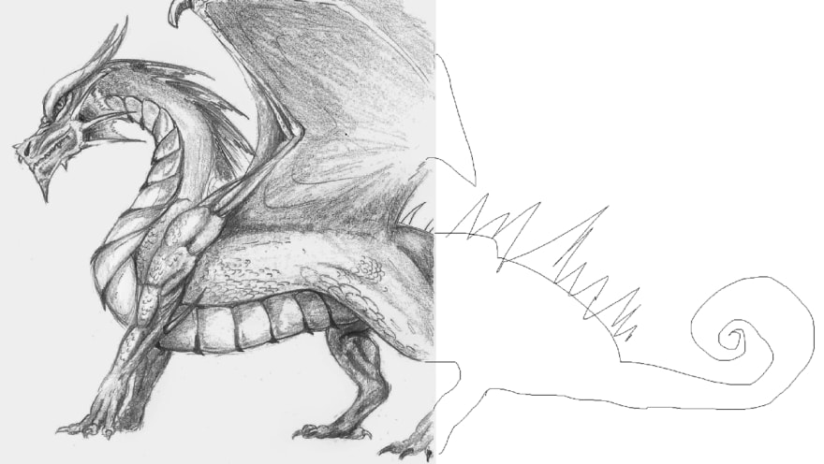
SQL knowledge

Slide 4
Is sitting the new smoking?
Studies say “maybe?”

Slide 5
What is “Programmer Back?”

Slide 6
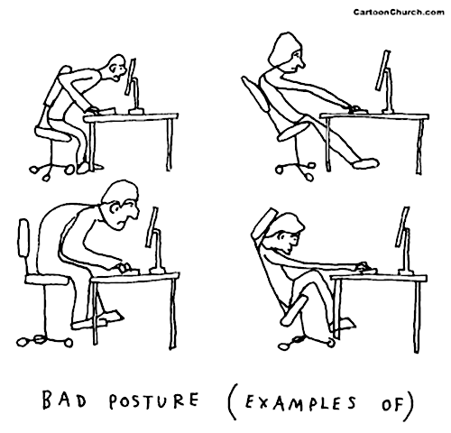

Slide 7
The Problems with Sitting
Compression of intervertebral discs
Reduced strength
Tightness in the hip flexors
Hunched shoulders and rounded upper back
Reduced abdominal strength
Reduced leg strength

Slide 8
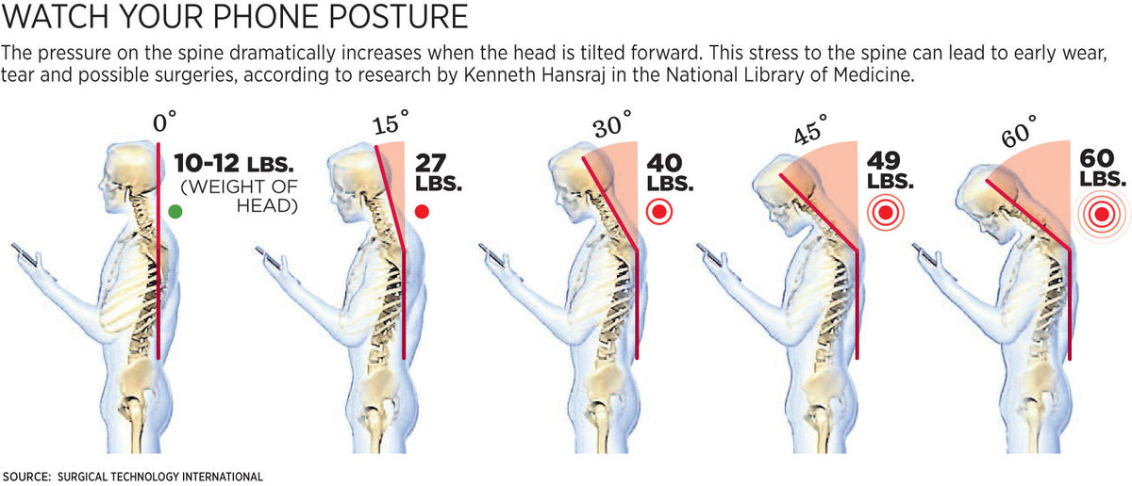
New Problem : “Text Neck”

Slide 9
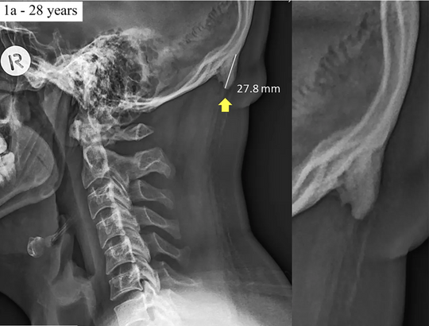
Can you get 'horns' from smartphone use?

Slide 10
ARE WE ALL DOOMED?

Slide 11
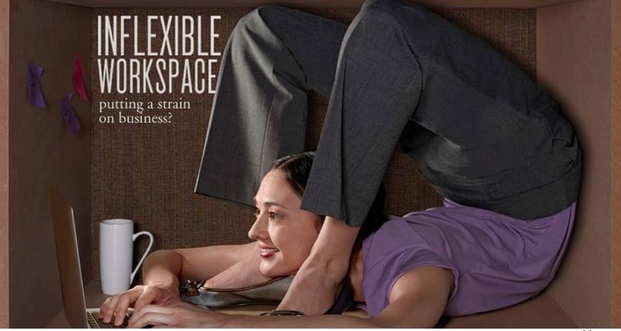
What do yogis and programmers have in common?

Slide 12
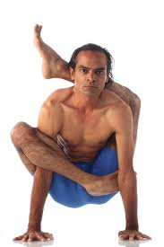
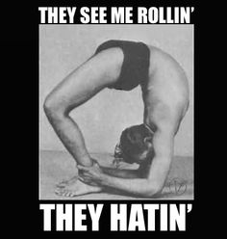
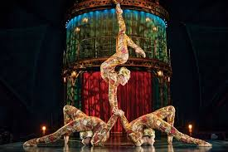
I’m not flexible!

Slide 13

I like to drink beer & eat burgers!

Slide 14
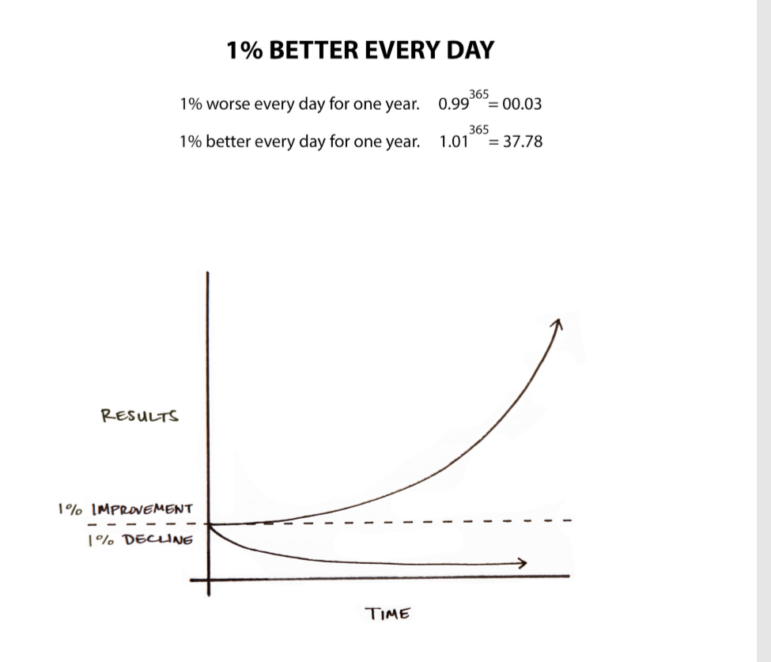

Slide 15


Slide 16
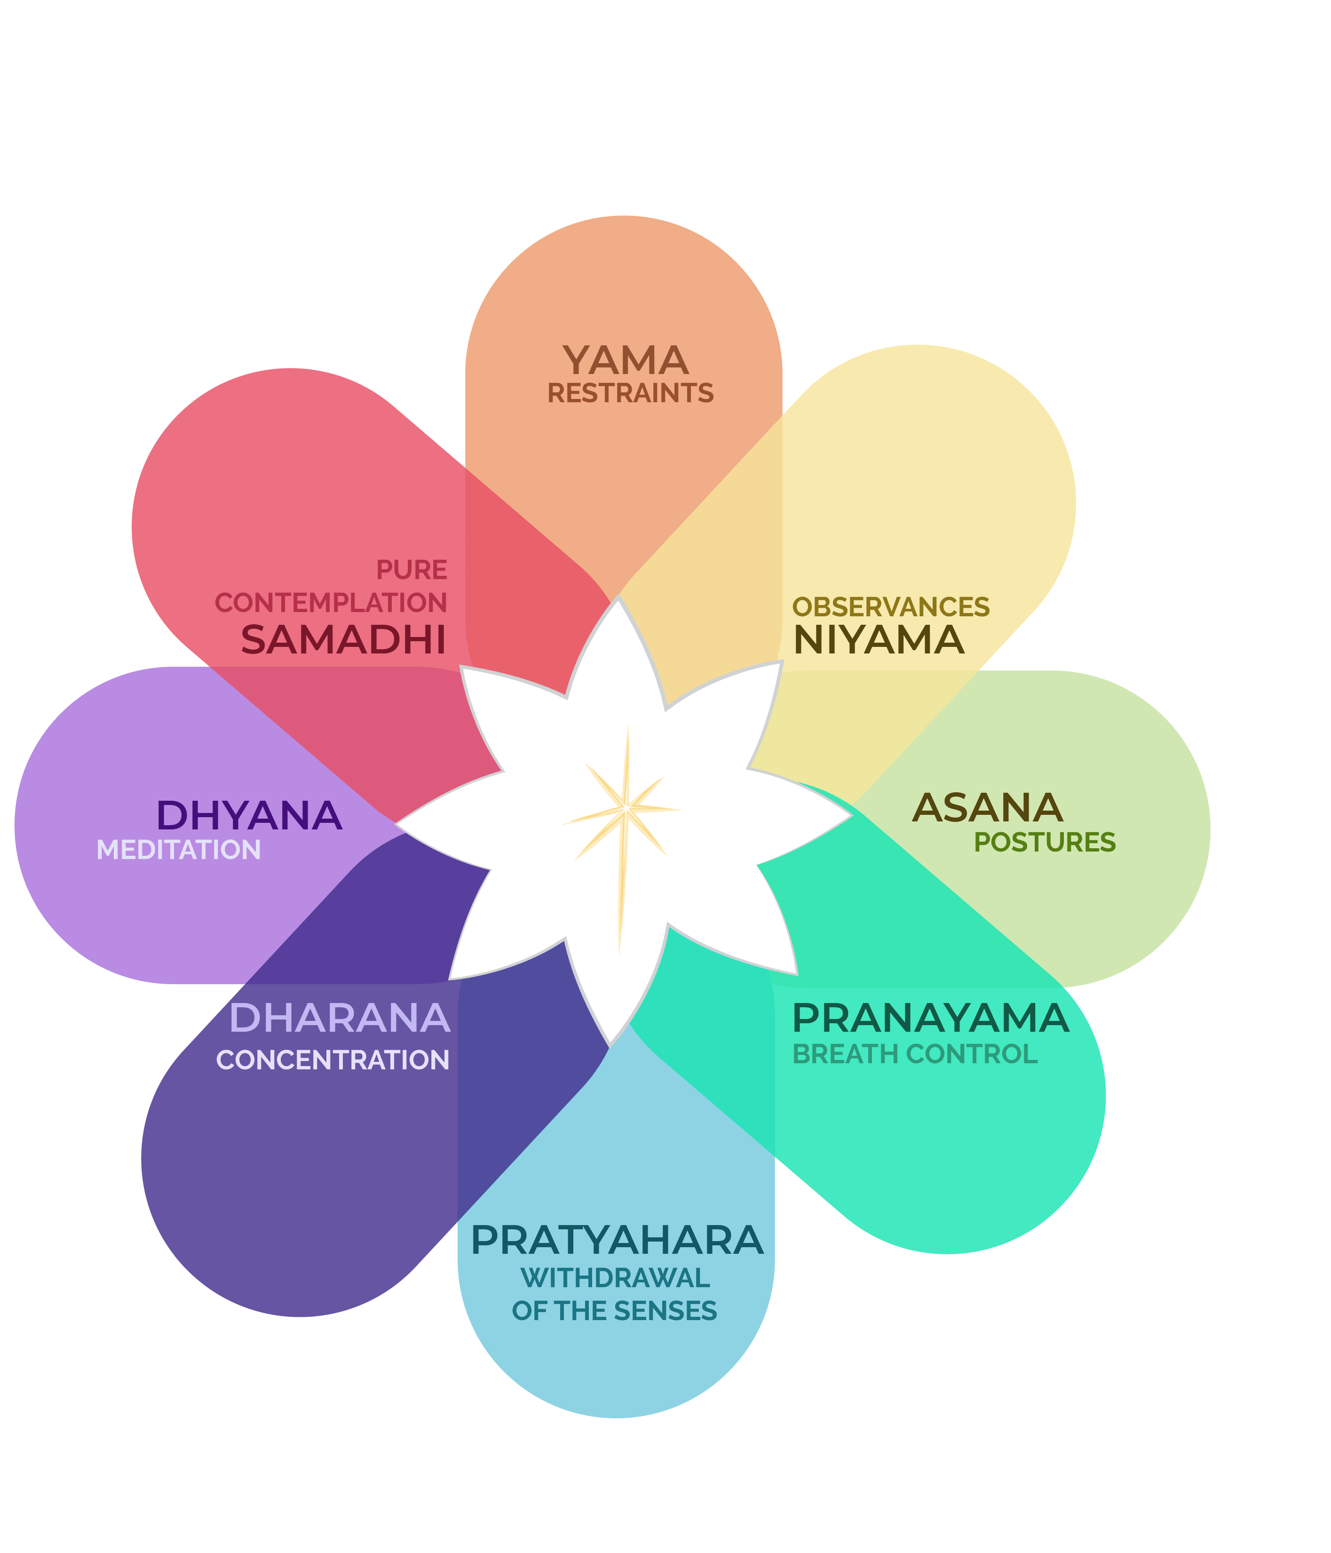

Slide 17
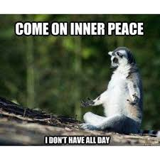
Now for the fun stuff!

Slide 18

Breathing is Hard!
a “natural tranquilizer” for the nervous system.”
soothe a racing heart
calm frazzled nerves

Slide 19
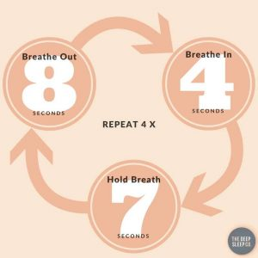
How to do 4-7-8 Breathing

Slide 20
10 essential poses (and benefits)
Side Bend (Half Moon):
strengthens every muscle in the body’s core,
Increases flexibility in the spine
Helps correct bad posture
Backward Bend:
Stretch the hip flexors
Opens up the shoulders and chest, an area where lots of us hold tension.
By increasing mobility and awareness of the spine backbends improve posture and can help to alleviate some kinds of back and neck pain.
Forward Bend:
Increases flexibility of spine and sciatic nerves
Strengthens the thighs and knees
Stretches the hamstrings, calves, and hips
Calms the brain and helps relieve stress and mild depression
Therapeutic for asthma, high blood pressure, infertility, osteoporosis, and sinusitis

Slide 21
Awkward 1 & 2:
Strengthens all muscles of thighs, calves and hips.
Increases hip flexibility
Increases blood circulation in knees and ankles
Firms upper arms
Eagle:
Flushes lymphatic system
Improves flexibility of hips, knees, ankles, shoulders, wrists.
Crossing the midline- helps development of motor and cognitive skills needed for left-right brain communication.
Standing Balancing:
Develops patience & concentration
Strengthens core, quadriceps and glutes
Improves flexibility of sciatic nerves.
Tree:
Strengthens thighs, calves, ankles, and spine
Improves sense of balance
Relieves sciatica and reduces flat feet

Slide 22
Spine Twist:
Stimulates the liver and kidneys, improved digestive function
Stretches the shoulders, hips, and neck
Relieves fatigue, sciatica, and backache
Maintain Normal Spinal Rotation
Traditional texts say that spine twisting destroys most deadly diseases, and awakens kundalini.
Savasana “Corpse Pose”:
Savasana is a pose of total relaxation—making it one of the most challenging.
Calms the brain and helps relieve stress and mild depression
Relaxes the body
Reduces headache, fatigue, and insomnia
Helps to lower blood pressure

Slide 23
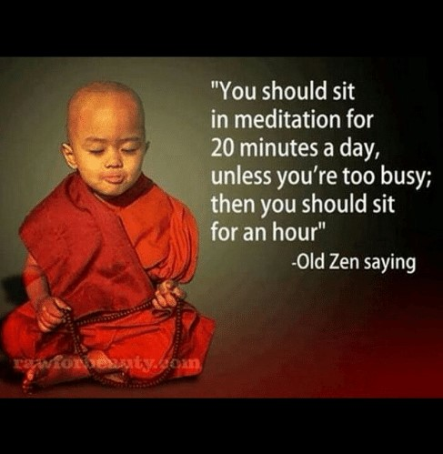

Slide 24


